Slide 1
Spatial Mnemonics using Virtual Reality
Eric Krokos, Catherine Plaisant, Amitabh Varshney
University of Maryland College Park
Notes:
Hey everyone, I’m Eric, along with my collaborators Catherine P and Amitabh V, are from the University of Maryland

Slide 2
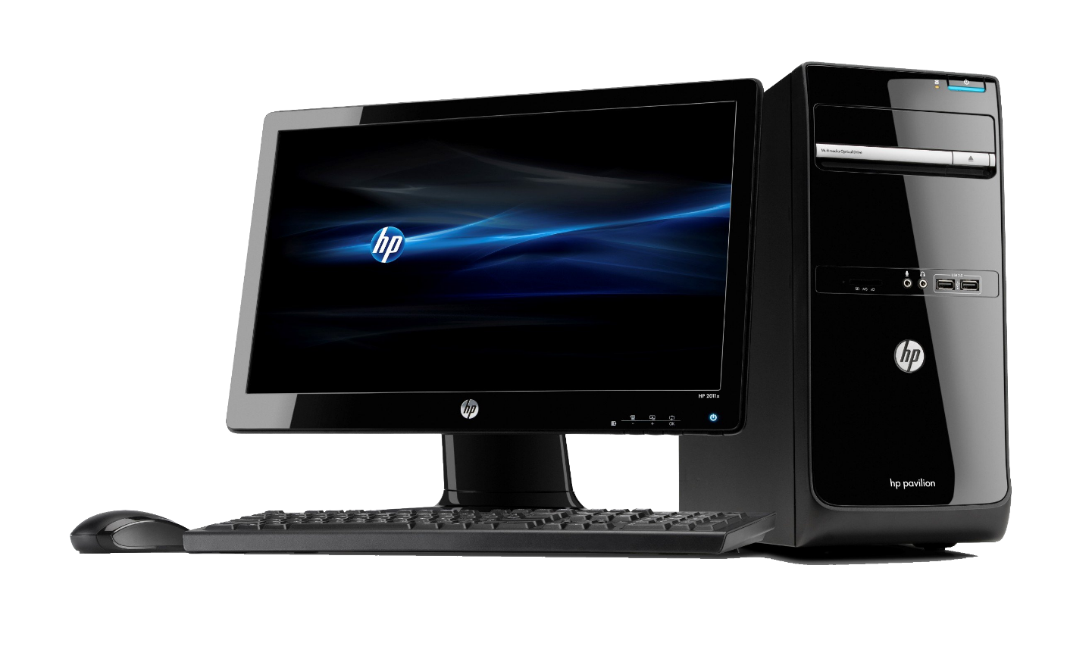
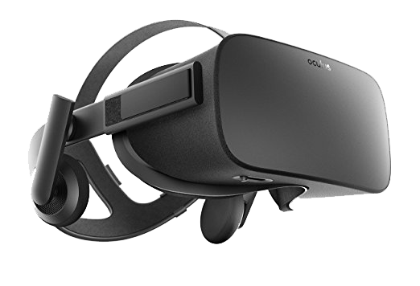
Immersion Aids Recall
>?
Notes:
Like many of you, we’re very excited about the amazing prospects of virtual reality. But, So far, virtual reality is typically associated and used for entertainment, and this makes sense, the increased immersion it offers makes things like video games more fun and realistic.
What I’m particularly interested in is if and how VR can be used for more productive endeavors, such as visualization or immersive analytics.
What about VR makes it better at these things than traditional desktops?
A critical question if VR is to have any place in the future.
One important aspect of any information visualization is for analysts to be able to gain an innate understanding of that data. Does VR allow people to ingest information, especially when presented spatially better?
One way to test that this is to test their ability to recall that information.
So essentially, the question we’re asking is – does immersion aid recall?

Slide 3
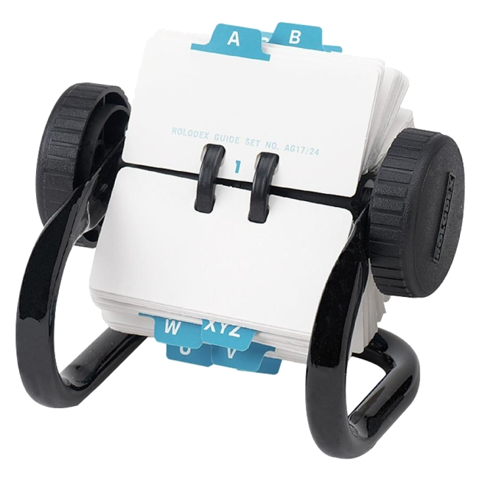
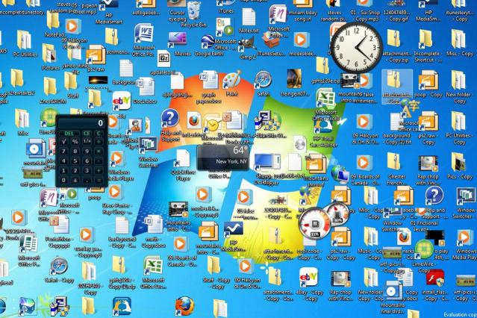
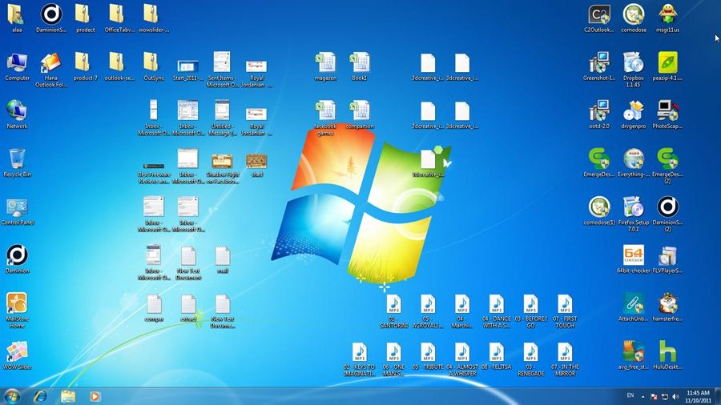

Why?
?
Notes:
First off, we’re spatial creatures. We live in and organize the space around us all in 3 dimensions.
Perhaps some of you have a desktop like this, with stuff just randomly placed all over.
I think we can agree that most of us would prefer something like this, with information spatially separated with similar things grouped together. Where we can find and recall where and what things are when organized in this way.
Considering “our parents” started with 1D rolladex’s, and now we use 2D desktops, the question is what’s next?
Is the next paradigm 3D? Using VR, can we leverage our innate 3D sense of space and make data organization more natural?
Surely the 2D interface used by desktops cannot the end all be all

Slide 4
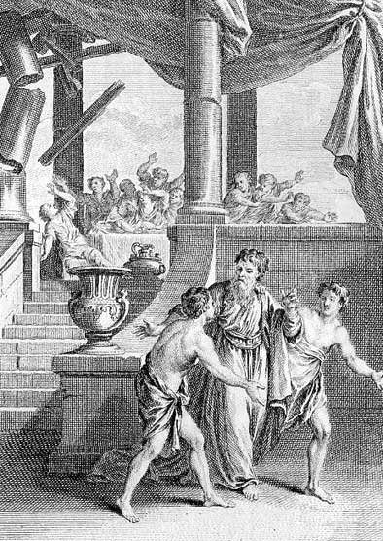
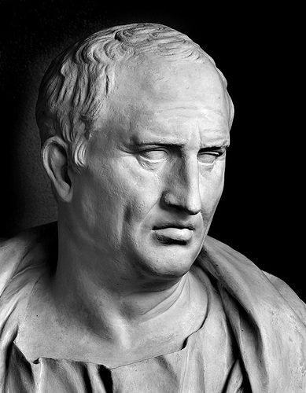
Historic Inspiration
Method of Loci
Memory Palace
Cicero - De Oratore (55 BC)
Simonides of Ceos (556 BC-468 BC)
Notes:
There is a historical basis for this. Going all the way back to the time of Rome, Cicero wrote a “book” called De Oratore, which tells the story of Simonides of Ceos
As the story goes, Simonides was a famous poet had recited some poetry at a house party. As he was leaving the house, the house suddenly collapsed, killing and mangling everyone inside beyond recognition.
The families of those killed asked Simonides to help them identify the bodies. So, Simonides stood where he had stood the previous night, reconstructed the house in his mind, and recalled who and where everyone had been.
This technique would become known as the Method of Loci, with Loci being plural for Locus, meaning place.
Today we call this a Memory Palace

Slide 5
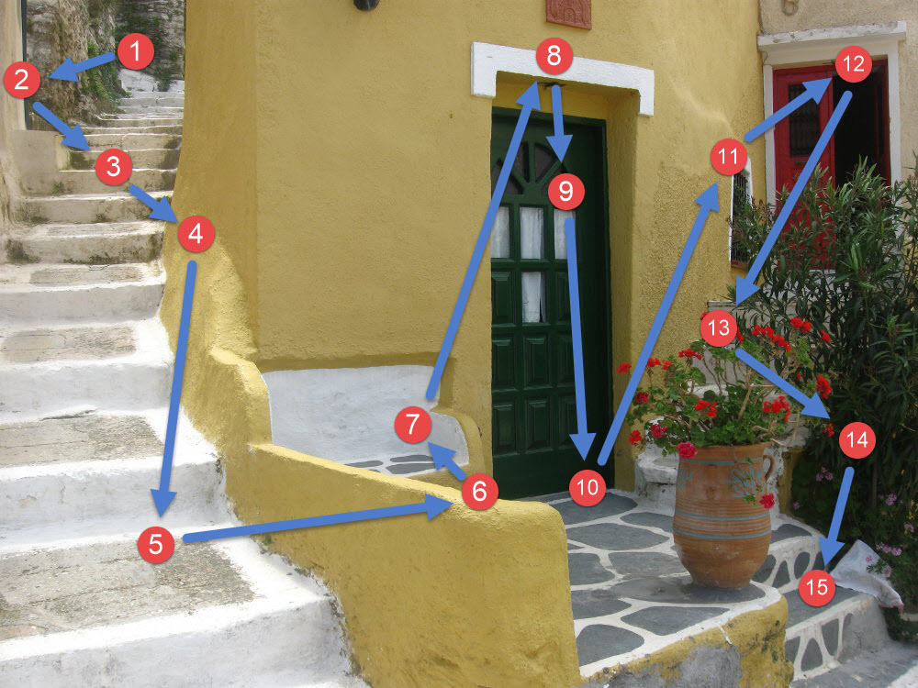
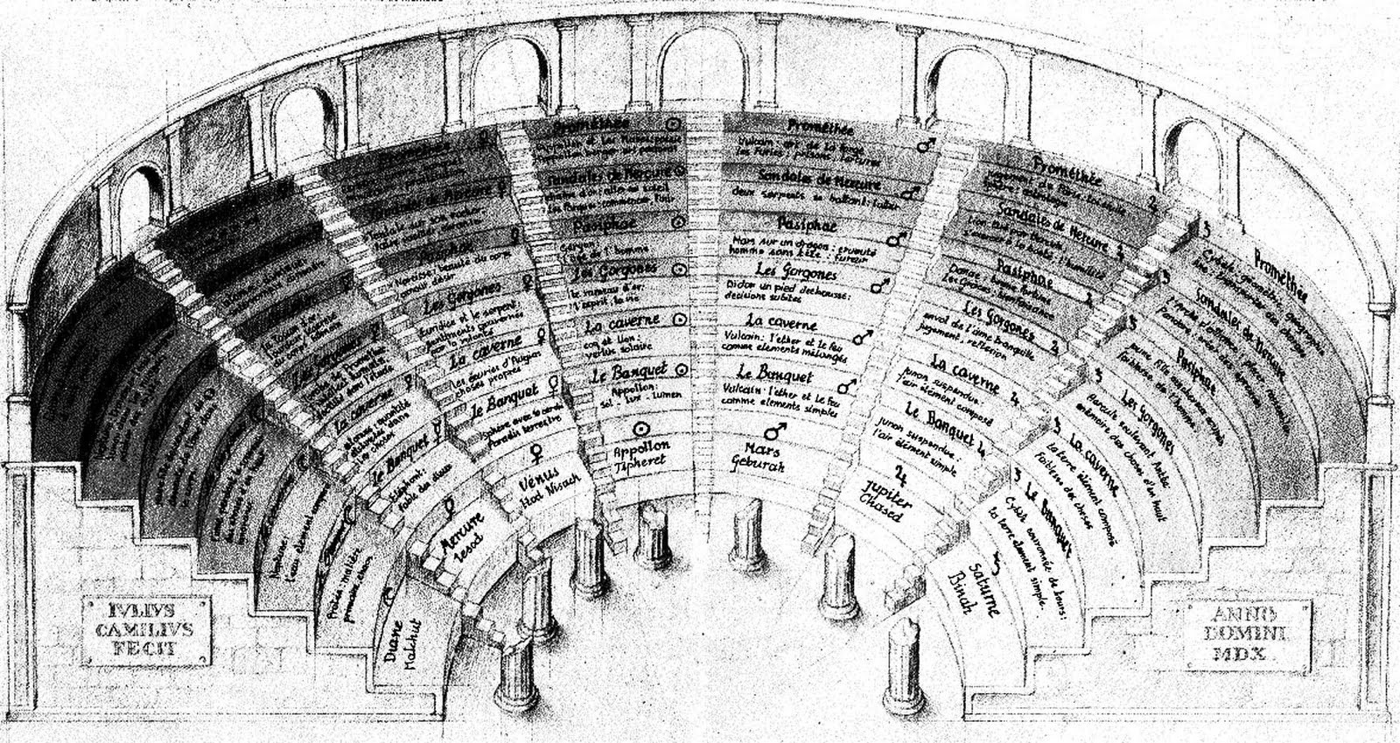
Building A Memory Palace
https://artofmemory.com/wiki/How_to_Build_a_Memory_Palace
Notes:
A memory palace is simple mnemonic technique. Back in ancient times, it’s been recorded in many different sources that poets and actors would often associate different versus or acts with the various parts of the arena or amphitheater around them. And that by simply looking at each section, would bring the particular words to mind. Cicero was famous for using this for his speeches in the roman senate.
Even today, there exist websites which offer tutorials on how to create your own memory palaces for your own needs. How to link and associate different objects and places with thoughts and ideas. This often includes using different parts of the environment to create a narrative, which can be used to encode and remember lists of things.

Slide 6
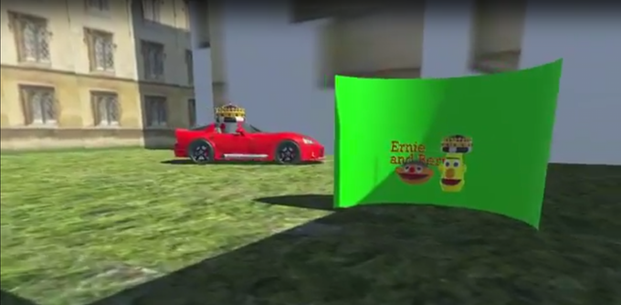
Memory Palaces in VR
Macunx VR
https://www.kickstarter.com/projects/macunx/macunx-vr-memory-palaces-in-virtual-reality
Notes:
In addition, there’s even a kickstarter for a tool whose goal is to help users build their own memory palaces in virtual reality

Slide 7
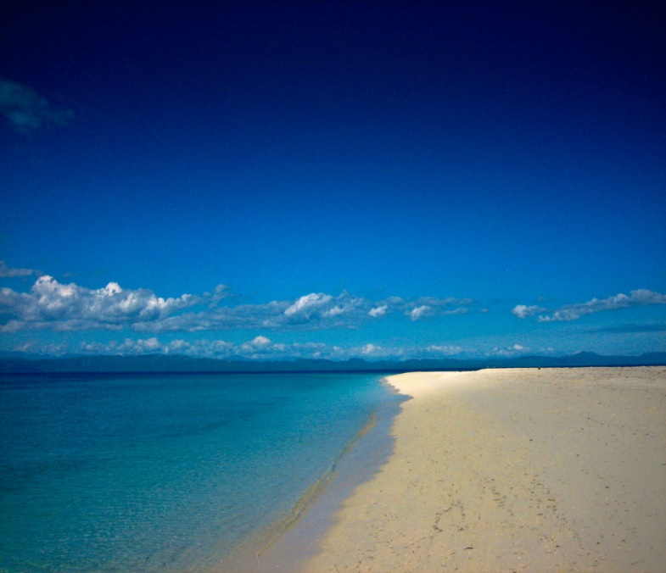
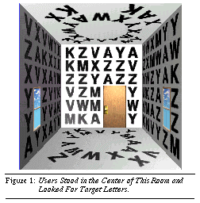
Important Related Works
Godden and Baddeley, BPS 1975
Pausch et al. Siggraph, 1997
Notes:
One work which we found to be very important was the work by Godden and Baddeley
What they did was conduct a user study to examine the impact of environmental context on memory recall. They had participants memorize a list of words either on land, or underwater, and then recall that list of words either in the same environment in which it was learned, or the opposite environment. They found that the environmental context had a huge impact on recall, and that recall accuracy in the learned environment was much higher than the recall in a different environment.
*Looking at you professors who don’t give exams in the lecture hall.*
Another important study was done by Randy Pausch. He had participants search for a hidden letter in a room full of letters on either a desktop or HMD. Interestingly, he found that there was no difference in search times between those who used the desktop and HMD. However, when he asked participants to confirm if a letter was present or absent from the room, participants using the HMD were able to confirm its’ presence or absence much more quickly than those using the desktop.

Slide 8
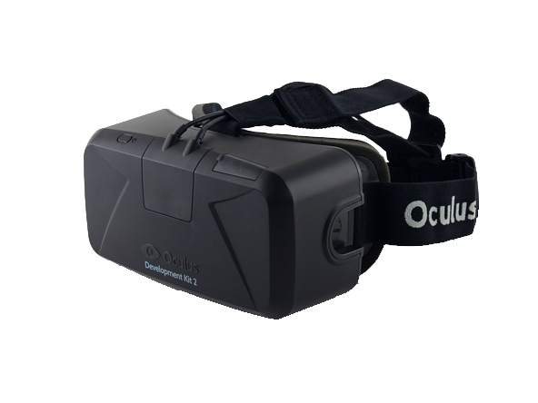

User Study
Our hypothesis is that a virtual memory palace experienced in an immersive head-tracked HMD will lead to a more accurate recall than on a mouse-controlled desktop display.
Notes:
In our study, we’re investigating our participants ability to recall information on a desktop as compared to a head mounted display. Our hypothesis is that those who use the head tracked HMD will have more accurate recall than those who use the desktop and mouse.

Slide 9
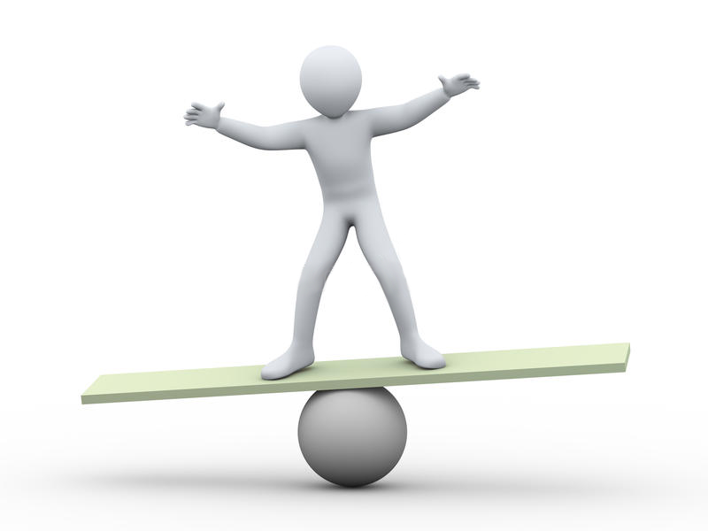
Our Contribution
Notes:
In particular, our goal is to determine if the increased immersion of the HMD, provided by its’ ability to leverage our vestibular and proprioceptive senses
(overall sense of body position, orientation, movement, and acceleration) would lead to higher recall accuracies for naturally distributed information.
In addition, in our study, we have participants perform recall in exact same environment and display as where the information was learned, rather than through a questionnaire or drawing representation of the space.

Slide 10
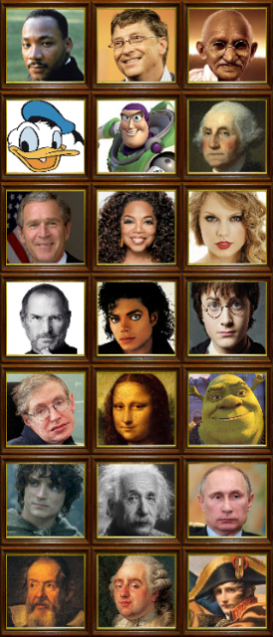
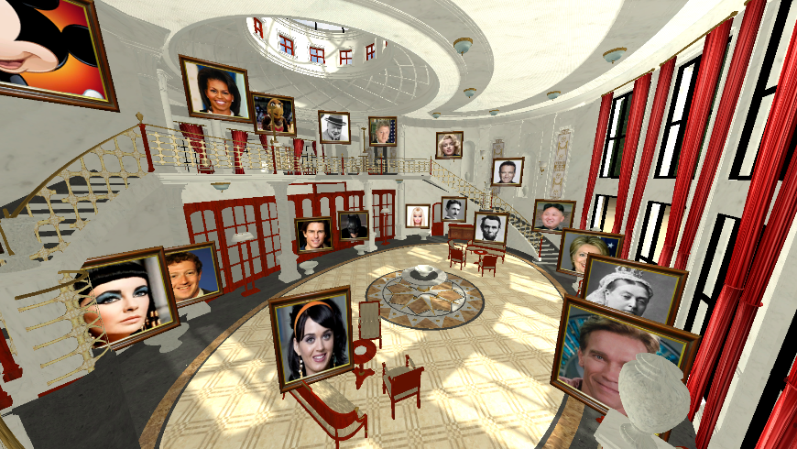

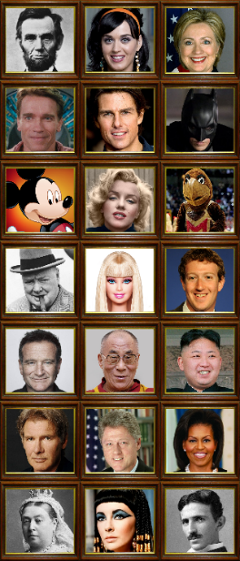
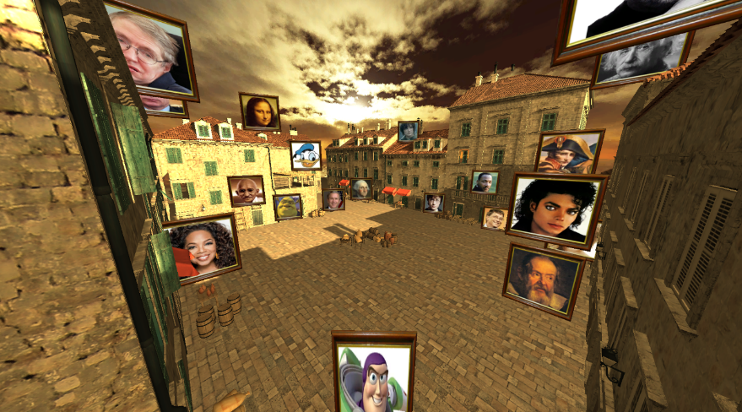
Setup
Notes:
In our study, we used two displays,
An Oculus HMD and a traditional desktop,
Along with two virtual environments, an ornate palace and medieval town,
And two sets of 21 faces as the information to be learned and recalled

Slide 11

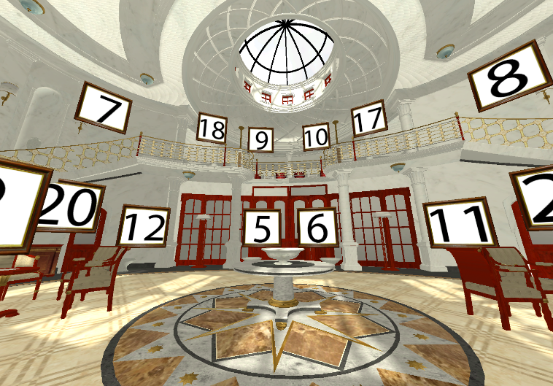
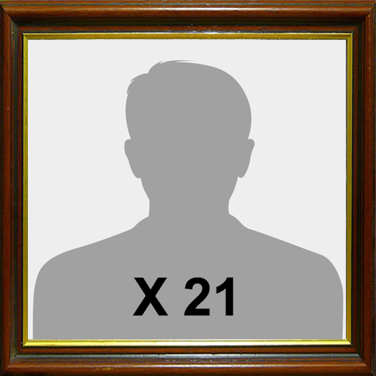

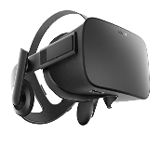
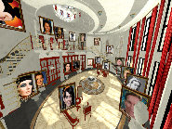


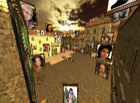
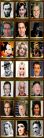

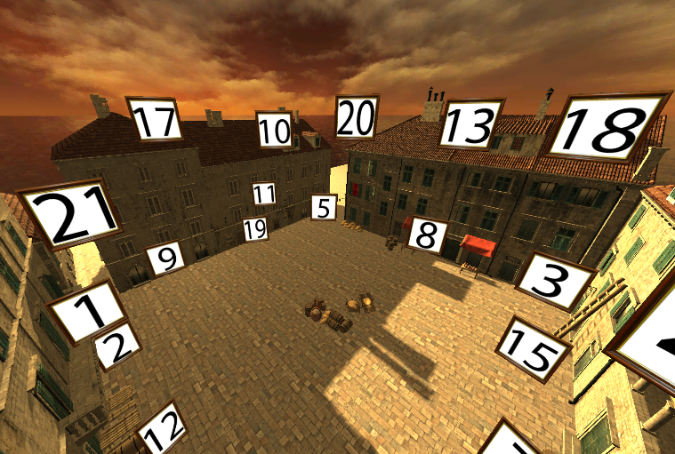

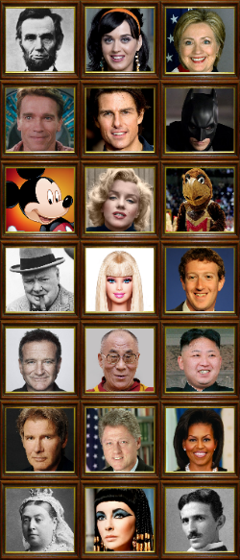
Process
Notes:
First, participants were given time to familiarize themselves with all 42 names and faces, which for the study are grouped into two equally familiar groups.
Once they were comfortable with the names and faces, participants would be placed in either the HMD or desktop, and be shown one of the environments with one of the sets of faces.
They would be given 5 minutes to familiarize themselves with the faces in the scene.
After the 5 minutes, participants were given a 5 minute break, where they were asked a series of distracting questions.
After the break, participants were placed back into the virtual environment using the same display, with the faces replaced with numbers. Participants would then be given 5 minutes to, in their own order, recall and verbally state which face was at each numbered location.
After this and a short break, participants would repeat the same process using the other display, environment, and set of faces.
The ordering of presentation was counter balanced across participants using a complete Latin square.

Slide 12
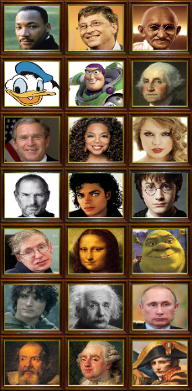


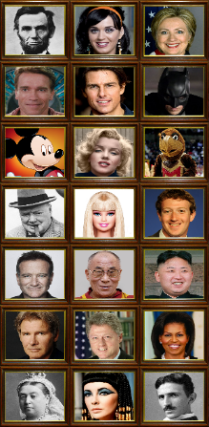

Four-Way Mixed ANOVA
Display Order:
F(1,79)=1.93
p > 0.05
Scenes:
F(1,79) = 0.27
p > 0.05
Face Sets:
F(1,79) = 0.27
p > 0.05
Notes:
First, we wanted to confirm that there were no statistically significant effects from the other variables using ANOVA.
Here, we can see that the ordering participants used each of the displays was not impactful.
Neither of the virtual scenes alluded themselves to a more accurate recall.
And the neither of the sets of faces was easier to recall than the other.

Slide 13
Desktop vs HMD
>
Display Condition:
F(1,79) = 4.5
p < 0.05
Notes:
However, for our main variable, the display condition (hmd vs desktop), we found that there was a statistically significant effect

Slide 14
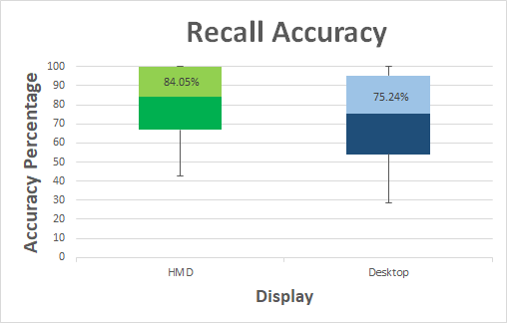
Paired T-Test
Bonferroni-Holm Correction
P = 0.0017 < 0.05
Notes:
Here we show the distribution of recall accuracies for the HMD and the desktop. The average recall accuracy for the HMD was 84% and the average recall accuracy for the desktop was 75%.
Using a paired t-test with bonferroni-holm correction, we found that our result was statistically significant.

Slide 15
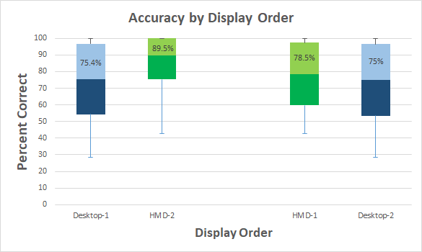
Desktop-1 to HMD-1
P = 0.62 > 0.05
HMD-2 to Desktop-2
P = 0.025 < 0.05
Notes:
Here we compare recall accuracies based on display order.
On the left we have those who used the desktop first, and then the HMD, and on the right we have those who used the HMD first, and the desktop second.
We found that there was not a statistically significant difference between those who used the desktop first, and those who used the HMD first
However, there was a statistically significant difference between those who used the HMD second, and those who used the desktop second.
We hypothesize that A possible explanation for this could be that those who used the HMD first are able to benefit from the HMD's superior immersion, which they lose when they transfer to the desktop. However, when the users start on the desktop they invest a greater effort to memorize the information and therefore when they transfer to the HMD, they not only keep their dedication but also gain from the improved immersion.

Slide 16
Conclusions
Had 40 participants memorize and recall faces in HMD and desktop.
Head-Mounted Displays offer advantages over Desktops
Statistically significant average recall accuracy increase of 8.8%
Gives insight into how to organize and present information in VR
Notes:
So to wrap up, we had invited 40 participants to memorize and recall the faces in both the HMD and desktop.
We found that there was a statistically significant average recall accuracy of about 9% in favor of the HMD
We hope that this study provides a scientific foundation for which we can begin to learn how to organize and present information in virtual reality using head mounted displays.

Slide 17
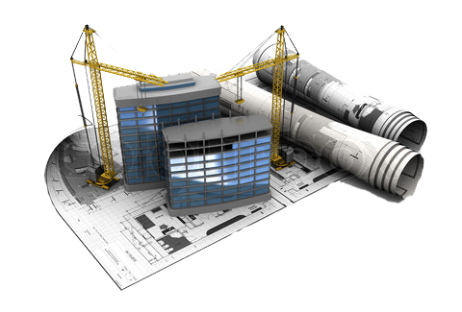

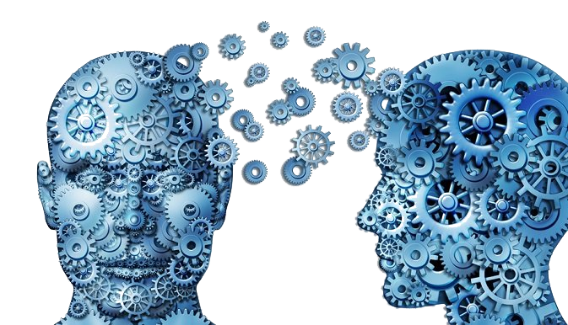
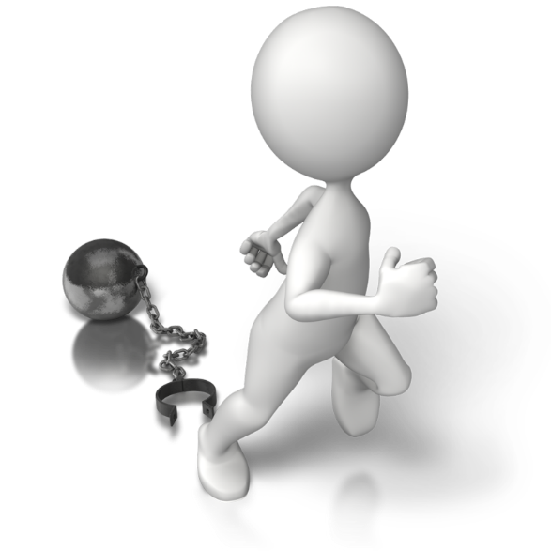
Future Work
Personalized construction of virtual memory palaces
Interactive placement of content
Impact of free navigation (rotation and translation)
The feasibility and impact of sharing virtual memory palaces
Notes:
Moving forward, there are many different directions one could take in expanding this initial study.
In our study, the two virtual environments were pre-constructed - it would be interesting to see what impact a personally constructed virtual environment would be.
In addition, the information in our scenes were statically placed. Again, a personal interactive placement of the content would likely affect the recall accuracies.
In our study, participants were not allowed to freely walk around the virtual environments, limited instead to only rotation. Does the ability to walk around make any difference?
Lastly, and perhaps most importantly, in any data investigation, there is often collaboration and sharing of results. Just as we have textbooks and videos for information dissemination, it could be possible for these virtual memory palaces to be used for an effective transfer of knowledge.

Slide 18
Thank You!
Funding Sources:
NSF Grants 14-29404 and 15-64212
NIST Grant 70NANB16H206
State of Maryland's MPower initiative
Notes:
And that’s it. Thank you!

